Slide 1
Classical Analysis of Rates
February 19th – 21st 2015

Slide 2
Objectives
Explain and compare the rates between two treatment groups
Understand weaknesses of “classical analysis” of rates – move to Poisson model

Slide 3
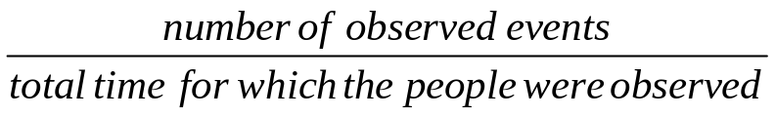
Rate
Number of events per unit time in a given number of people
For any group of people it is calculated as:
Difference between risk and rate:
  Risk: probability of experiencing an event
  Rate: probability of experiencing an event per unit time

Slide 4
Rate
Rates are applied to individuals
They can only be measured from a group of participants
Key assumption: events occur uniformly over time i.e. rate is constant
Example: if 5 events occur in 100 men over 2 years, what is the event rate?
  No. of events: 5
  Total time of follow-up: 100 men x 2 years = 200 person-years
  Event rate = 5/200 = 0.025 events per person-year

Slide 5
Rate ratio
Its the ratio of two rates
Example: if 5 events occur in 100 men over 2 years, and 10 events occur in 100 women over 5 years, what is the rate ratio comparing event rates in men vs. women?
  Event rate for men = 5/200 = 0.025 events per person-year
  Event rate for women = 10/500 = 0.02 events per person
  Rate ratio comparing men to women = 0.025/0.02 = 1.25
  Interpretation: the event rate in men is 1.25 times that in women
Length of follow-up is different for men and women, but rate ratio is a standardised measure for different lengths of follow-up. It has no units.

Slide 6
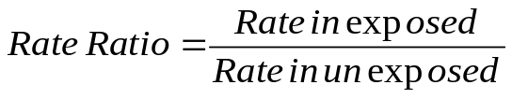
Rate ratio
Comparing 2 groups with respect to exposure status:
Alternative ways of expressing this:
  Rate in exposed = rate in unexposed x rate ratio
  Log(rate in exposed) = log(rate in unexposed) + log(rate ratio)
If there is more than one exposure factor:
  Log(rate in exposed) = log(rate in unexposed) + log(rate ratio for exposure 1) + log(rate ratio for exposure 2) e.t.c.
    Which is the Poisson model
A Poisson model is given by: log(λ) = Baseline + A + B
Exponentiate result to get the rate

Slide 7
Using R
Using creditcards data - ‘Classical’ analysis of rates
  Compute the rate of group 1 (income)
  Compute the rate of group 2 (credit)
  Compute the rate ratio = use of credit card given income
With poisson model - The offset variable serves to normalize the fitted cell means per some space, grouping or time interval in order to model the rates.
>data=read.table(creditcards.txt)
>lcases=log(cases)
>data=cbind(data,lcases)
>colnames(data)=c("income","cases","CrCards","lcases") data
## Fit the data with poisson linear model with offset=lcases >log.fit=glm(CrCards~income+offset(lcases),family=poisson,data=data )
>summary(log.fit) # to see the results

Slide 8
Weaknesses of ‘Classical’ analysis of rates
The assumption of constant rate ratio (ranges between –inf to inf) = not true
  The rate ratio takes zero to infinity
We use log transform as an alternative
  exponentiate back the results
Many simultaneous rates (combined effect of different exposures) cannot be analyzed “classically”
Cant tell weather the variable is a significant variable

Slide 9
Poisson regression Model for rate data
Assumptions for Poisson
  Log of disease rate changes linearly with equal increment increases in exposure variable
  Change in the rate from combined effects of different exposures or risk factors are multiplicative
  At each level of covariates the number of cases has variance equal to mean
  Observations are independent

Slide 10
Thanks

